Slide 1
Haptics Technology as a Physical Therapy Treatment Technique
Bret Oplinger
Advisor: Dr. Bishop
Second Reader: Prof. Jackowitz

Slide 2
Brief Description
My project would task a user with practicing writing with the hope of regaining the desired functionality in their wrist and/or hand

Slide 3
Background

Slide 4
Haptics
Definition
The study or use of tactile sensations and the sense of touch as a method of interacting with computers and electronic devices

Slide 5
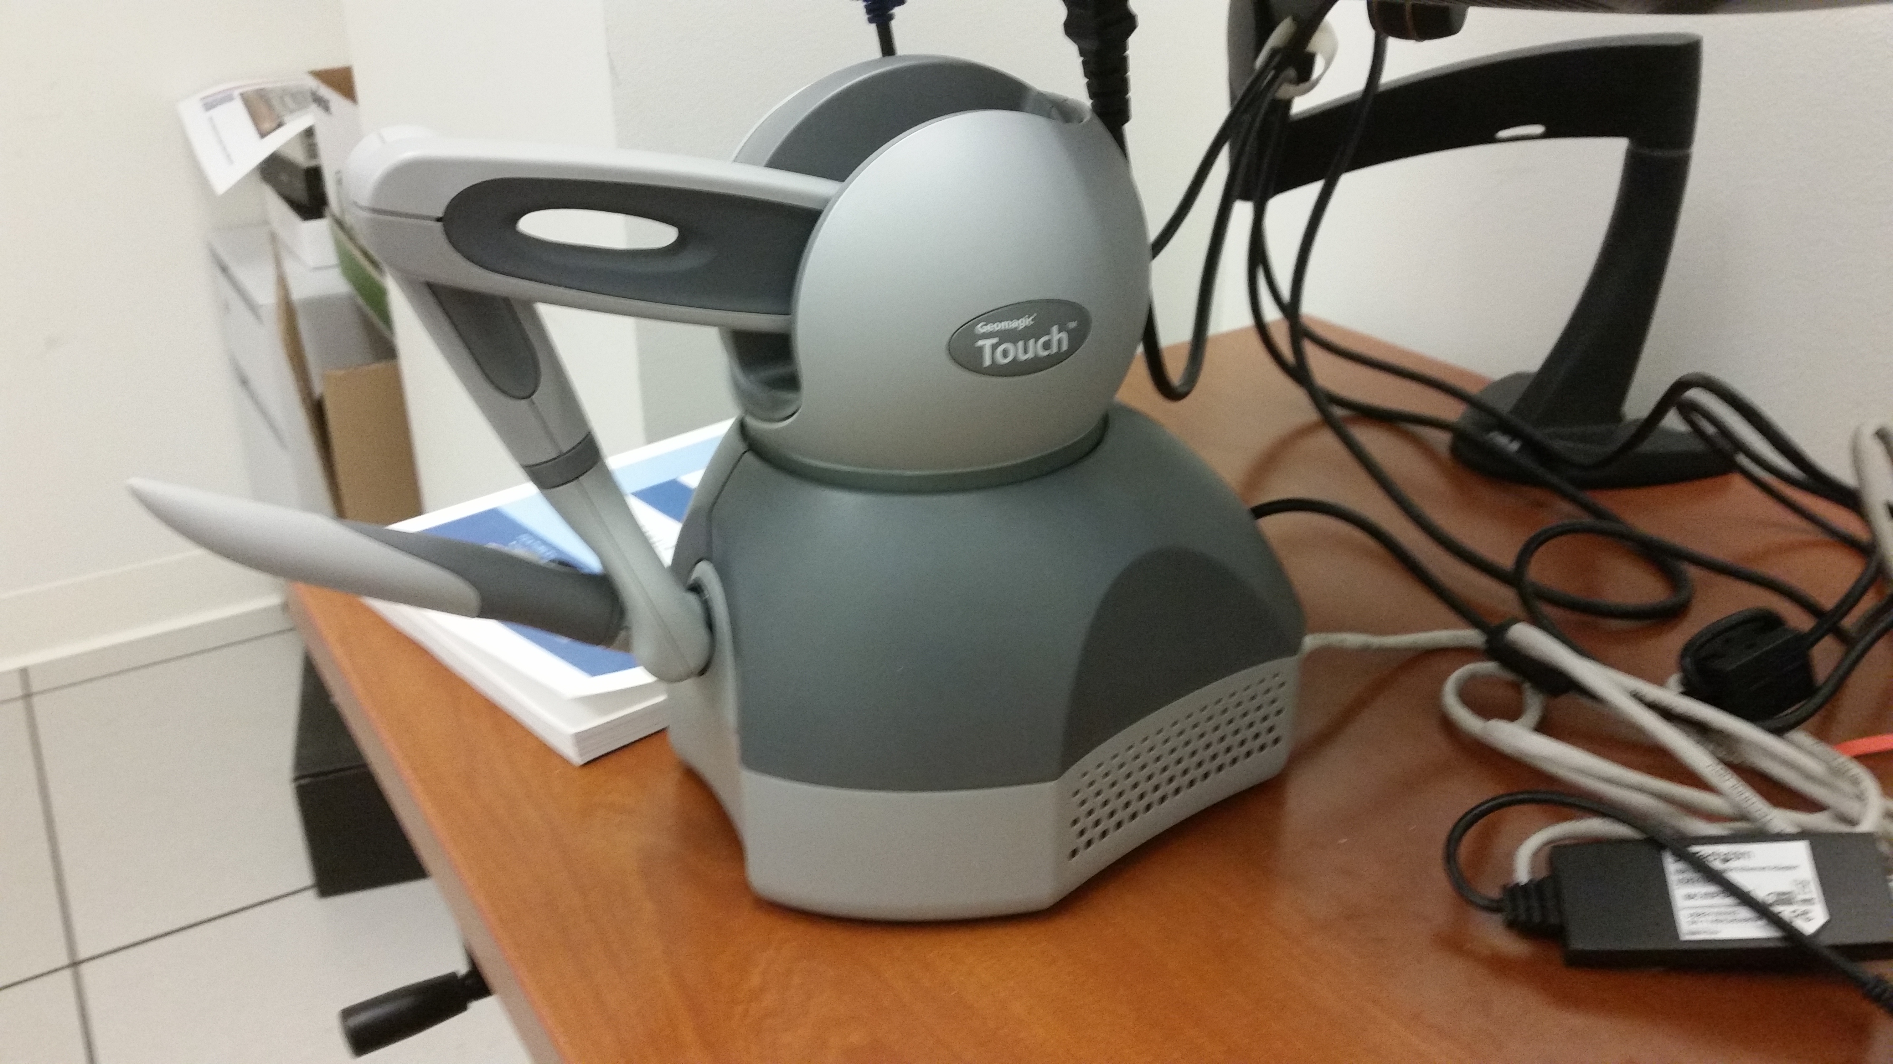
Haptics device

Slide 6
Physical Therapy
Robotic and virtual reality systems
Neuroplasticity
Fitts’ Law
Notes:
Robotic and virtual reality systems used to train individuals with loss of motor functions
Based on principles of motor learning and neuroplasticity, task-oriented repetitive movements using these systems provide the experience, timing, motivation and attention necessary to improve motor function.
Robotic devices can mimic some of the features of a therapist’s manual assistance, allowing patients to semi-autonomously practice their movement training.
With respect to rehabilitation and recovery, neuroplasticity can be described as the ability of the nervous system to respond to intrinsic and extrinsic stimuli by reorganizing its structure, function and connections.
With evolution of neuroplasticity research, contemporary, task-oriented rehabilitation has emphasized high repetition, intense training of meaningful tasks in environments offering high motivation to the learner with enhanced feedback (visual, auditory, haptic) about the results of performance
Fitts’ law predicts that the time required to rapidly move to a target area is a function of the ratio between the distance to the target and the width of the target.

Slide 7
OpenGL
Open Graphics Library
Cross-language, multi-platform API for rending 2D and 3D graphics.

Slide 8
OpenSCAD
Free software application for creating solid 3D CAD objects
3D compiler based on a textual description language
Notes:
CAD = computer-aided design
Solid CAD objects

Slide 9
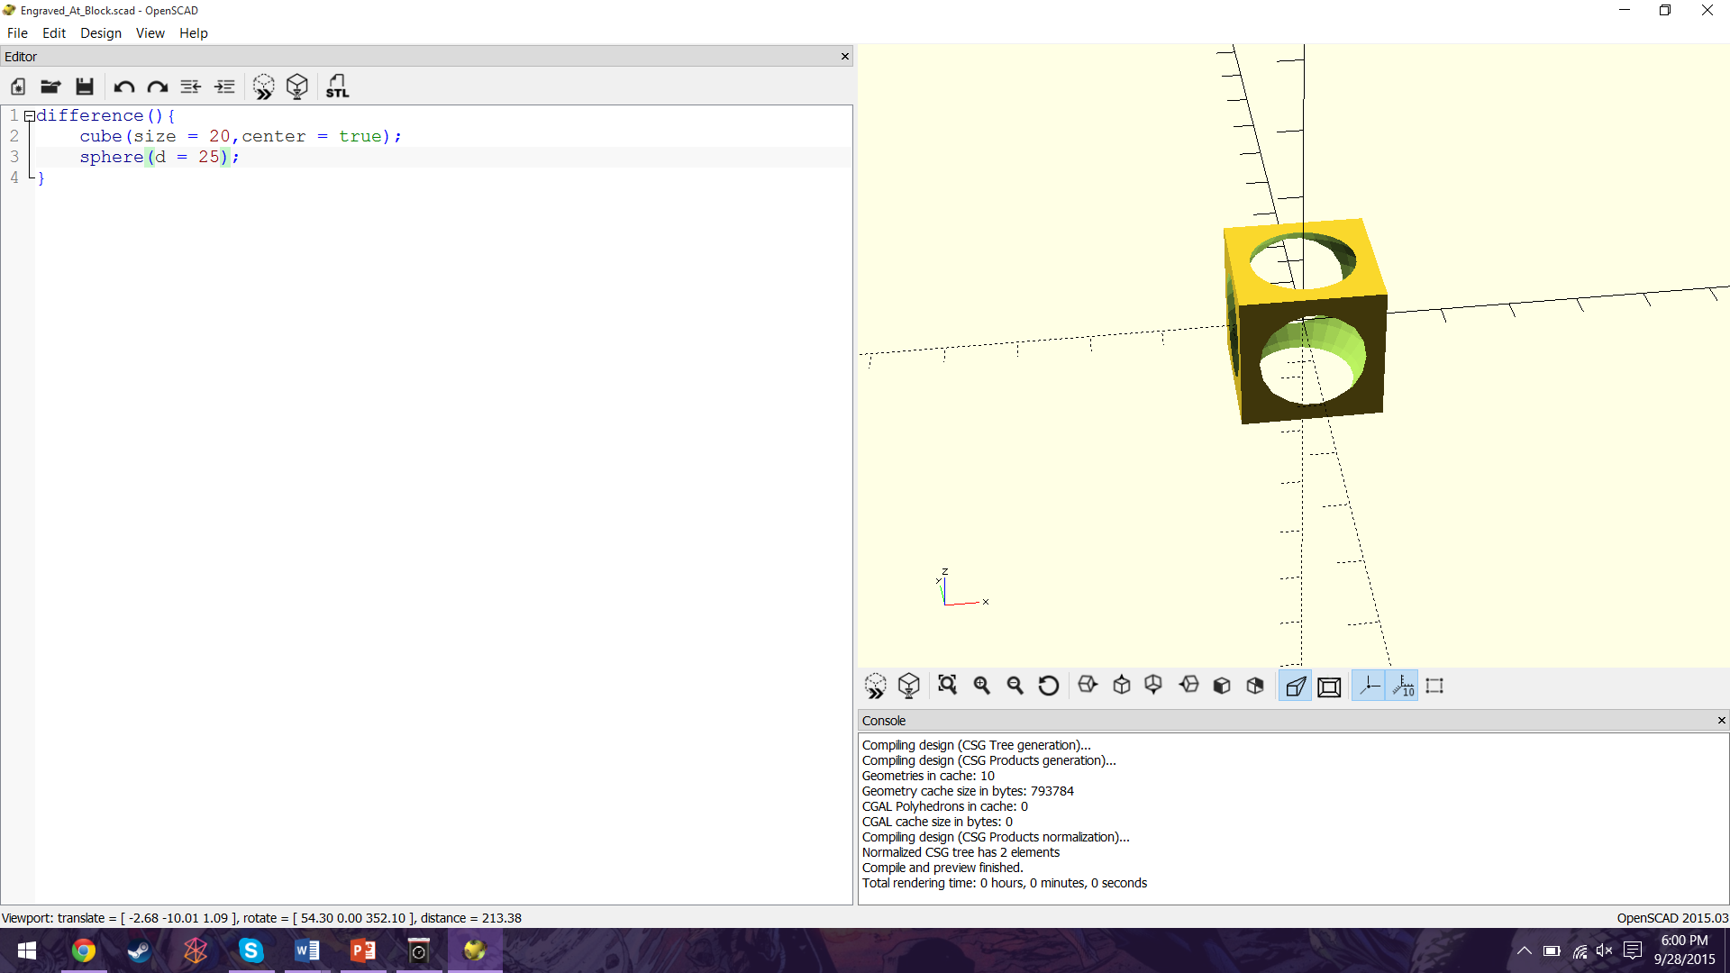
OpenSCAD example

Slide 10
Haptics Technology as a Physical Therapy treatment technique
Two parts to my thesis:
PTHaptics application
Letter partitioning research
Notes:
The PTHaptics application maintains a three dimensional block with a word engraved in it. The user manipulate the stylus attached to the haptics device to interact with application and traces the word inside the block. The letter partitioning research delves into finding and implementing an algorithm to divide a letter into polygons.

Slide 11
PTHaptics

Slide 12
Run through
User selects one of three PTHaptics shortcuts
User prompted for input
Word blocks generated from user input
User practices writing
User completes the level

Slide 13
1. User selects desktop shortcut
3 shortcuts on desktop for the application
One for each level
Determines which level user practices on

Slide 14
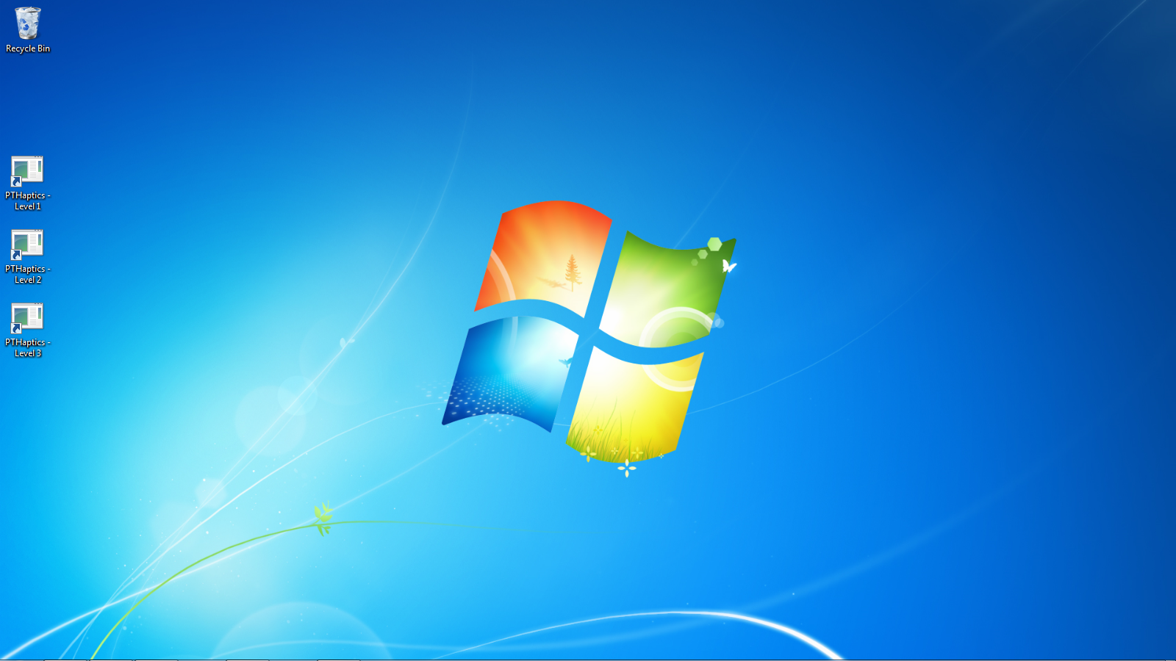
1. User selects desktop shortcut
Notes:
Each icon is a shortcut to the PTHaptics.exe. They differ in that a different run time variable is passed to PTHaptics. The run time variable is the wanted width of the word in the block. The first level has three times the width as the original word. The second level has two times the width as the original word. The third level has the width as the original word.

Slide 15
2. User prompted for input
User is prompted to enter:
User number
Word
Font type
Notes:
When the program is launched, the user is prompted to provide three different items: user number, word and font type.
The user number consists of three digits and is the name of the file containing the user’s session information.
The word is the string that the user will be practicing on.
The user can then choose between cursive or print font types
The level is selected depending on which desktop shortcut the user selects, so only one level is loaded now.

Slide 16
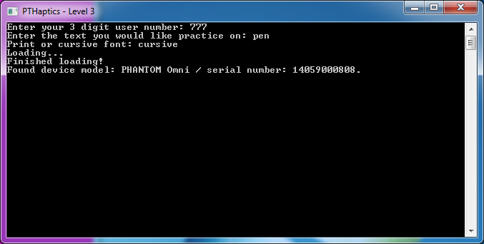
2. User prompted for input

Slide 17
3. Word blocks generated from user input
3 different 3D models can be dynamically generated
Word text and font are passed a command line call to an OpenSCAD script
Each model corresponds to a different level:
Standard size
2x size
3x size

Slide 18



Level 1 example
Level 2 example
Level 3 example

Slide 19
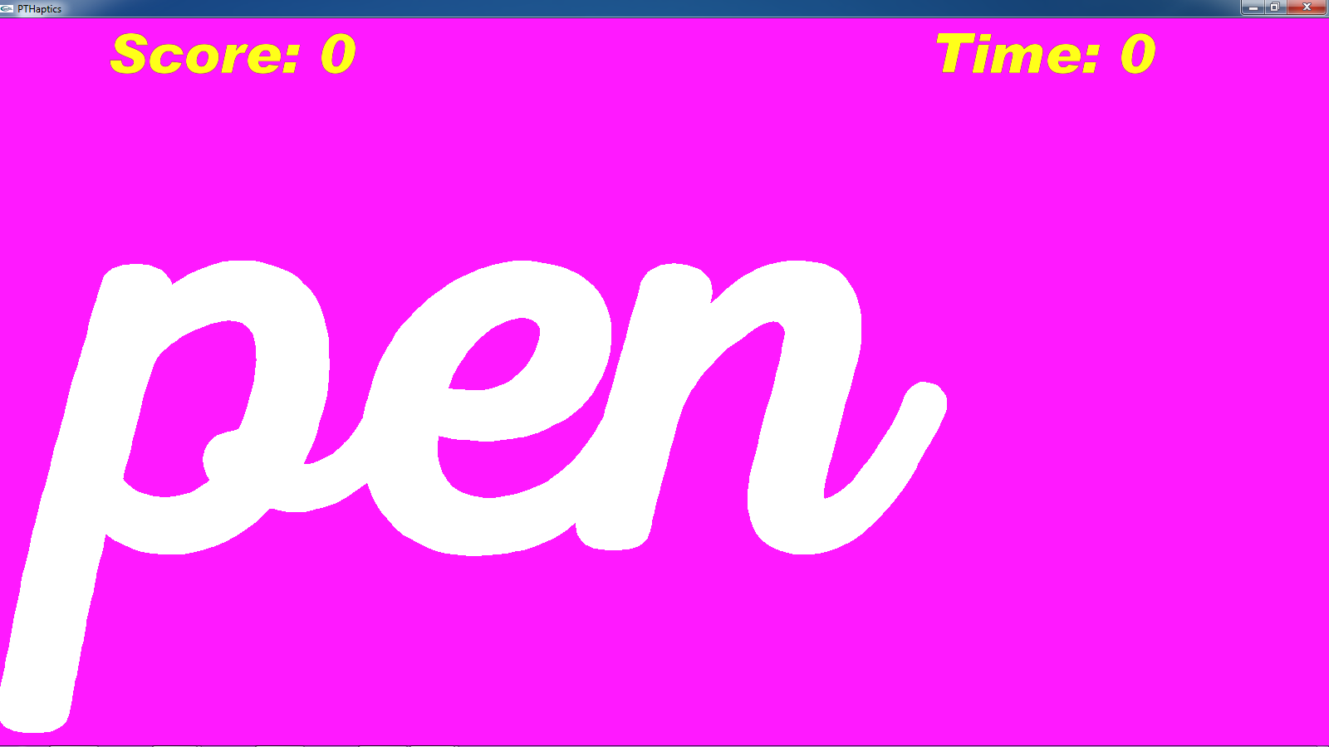
4. User practices writing
Notes:
The user must then trace the word as best as they can without touching the side of the purple block.
Their elapsed time and score is also displayed. The score corresponds to the number of the user’s collisions with the sides of the block.
To indicate and keep track of a user’s progress, a seventeen by seven grid is placed inside the models. Each time the user touches one of the squares in this grid with the haptics device, the currently touched grid square changes color and the total number of grid squares touched increases.

Slide 20
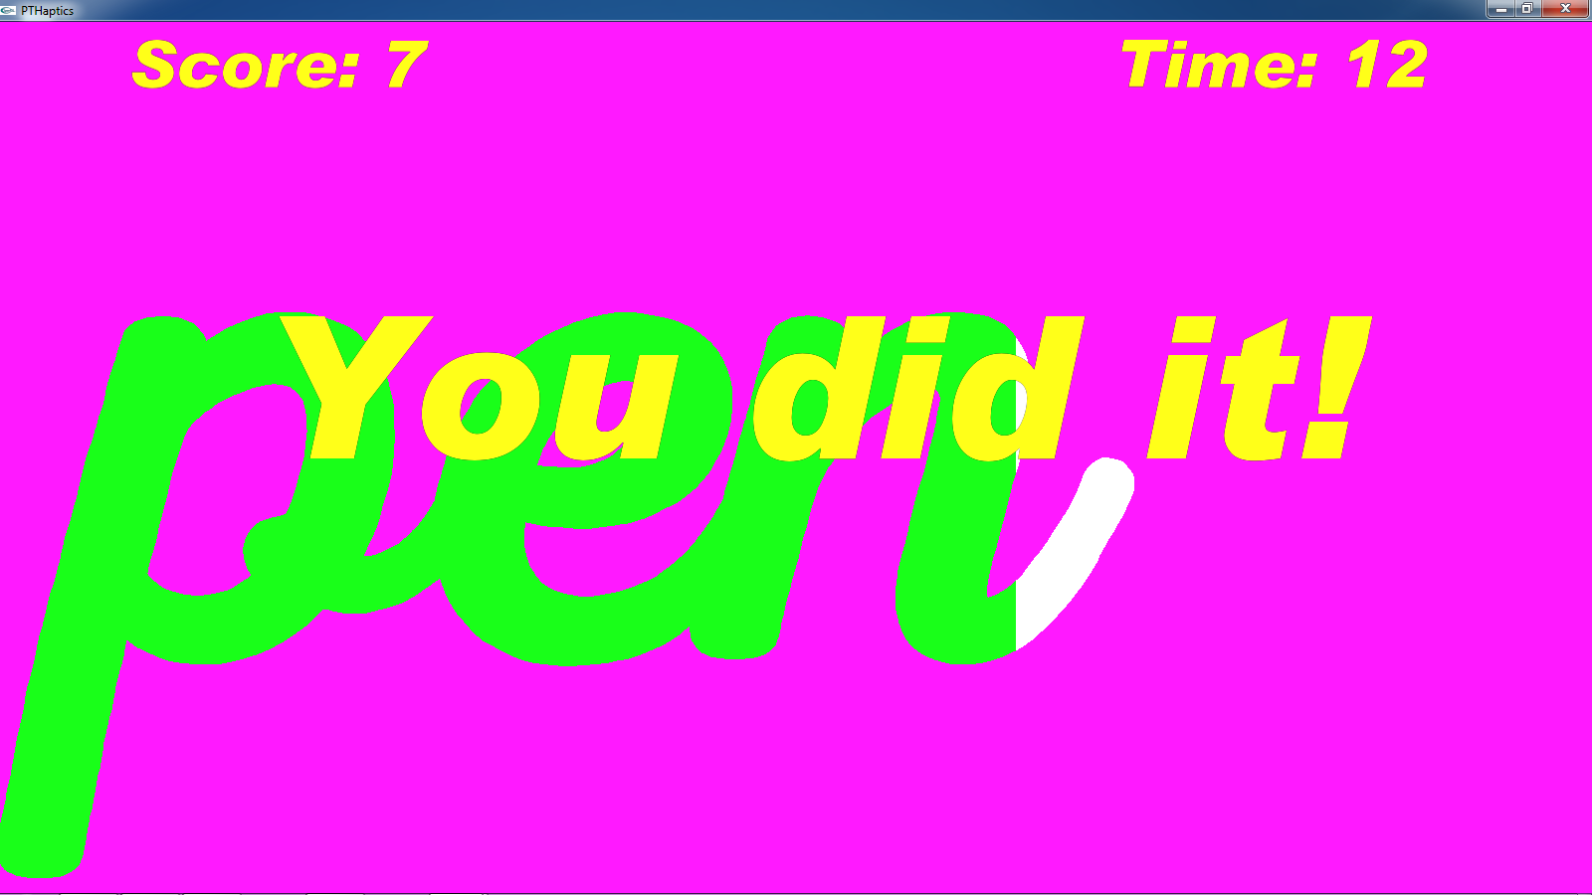
5. User completes the level
Notes:
When enough of the grid has been touched, the user completes the level.
Along with this message and button, the session data (so collisions, elapsed time, etc.) is saved in the file with their user number.
The user is able to go through the three generated levels as much as they want.
To change, user number, word or font type, the application needs to be restarted.
Back to menu button has been removed.

Slide 21
Letter partitioning

Slide 22
Letter partitioning
What’s wrong with current implementation?
What’s the end goal?
Potentially helpful algorithms:
Art gallery problem
Hertel-Mehlhorn algorithm
Approximate decomposition
Voronoi diagram

Slide 23
What’s wrong with current implementation
Have to estimate number of grid squares needed to light up to win
75% of grid not used per level
Possible to win without tracing whole word
Notes:
On the highest level (where the example above is of the lowest), I came up with the number ten grid squares need to be filled in per letter for the user to win.

Slide 24
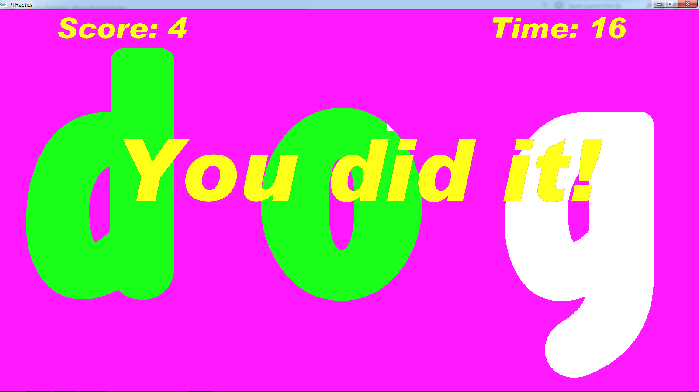
Example of what’s wrong with implementation

Slide 25
Solution

Slide 26
Voronoi diagram

Slide 27
Random sites in letter

Slide 28
Fitness function

Slide 29
Future work

Slide 30
Questions?

Slide 31
Demo

